Slide 1

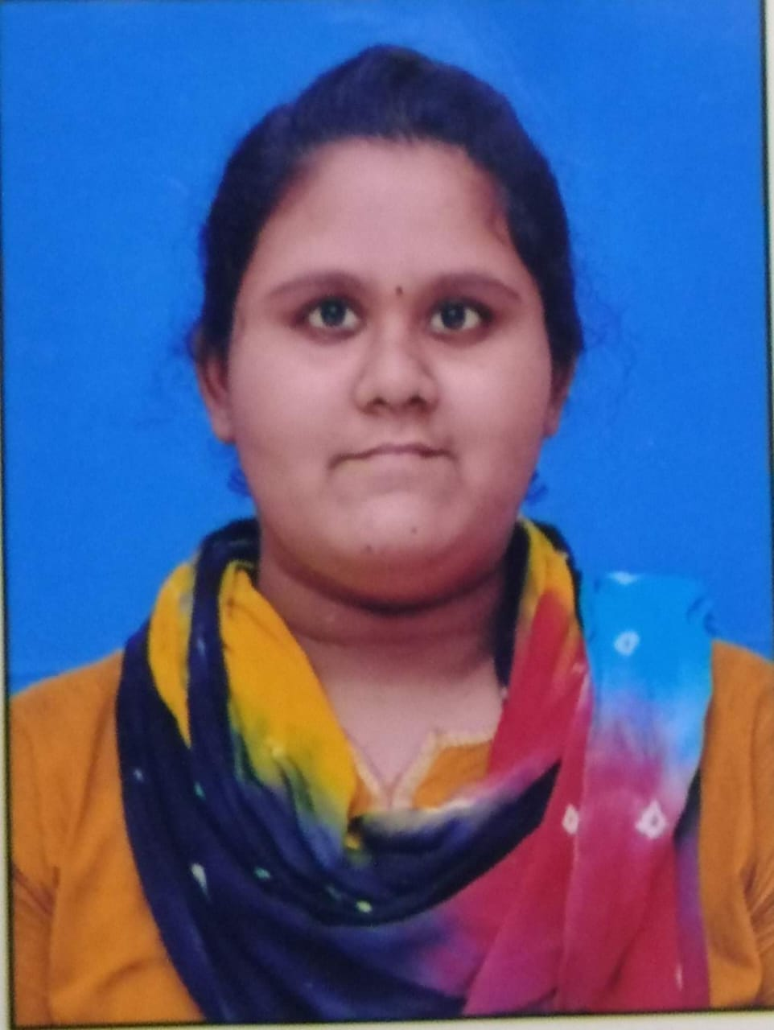

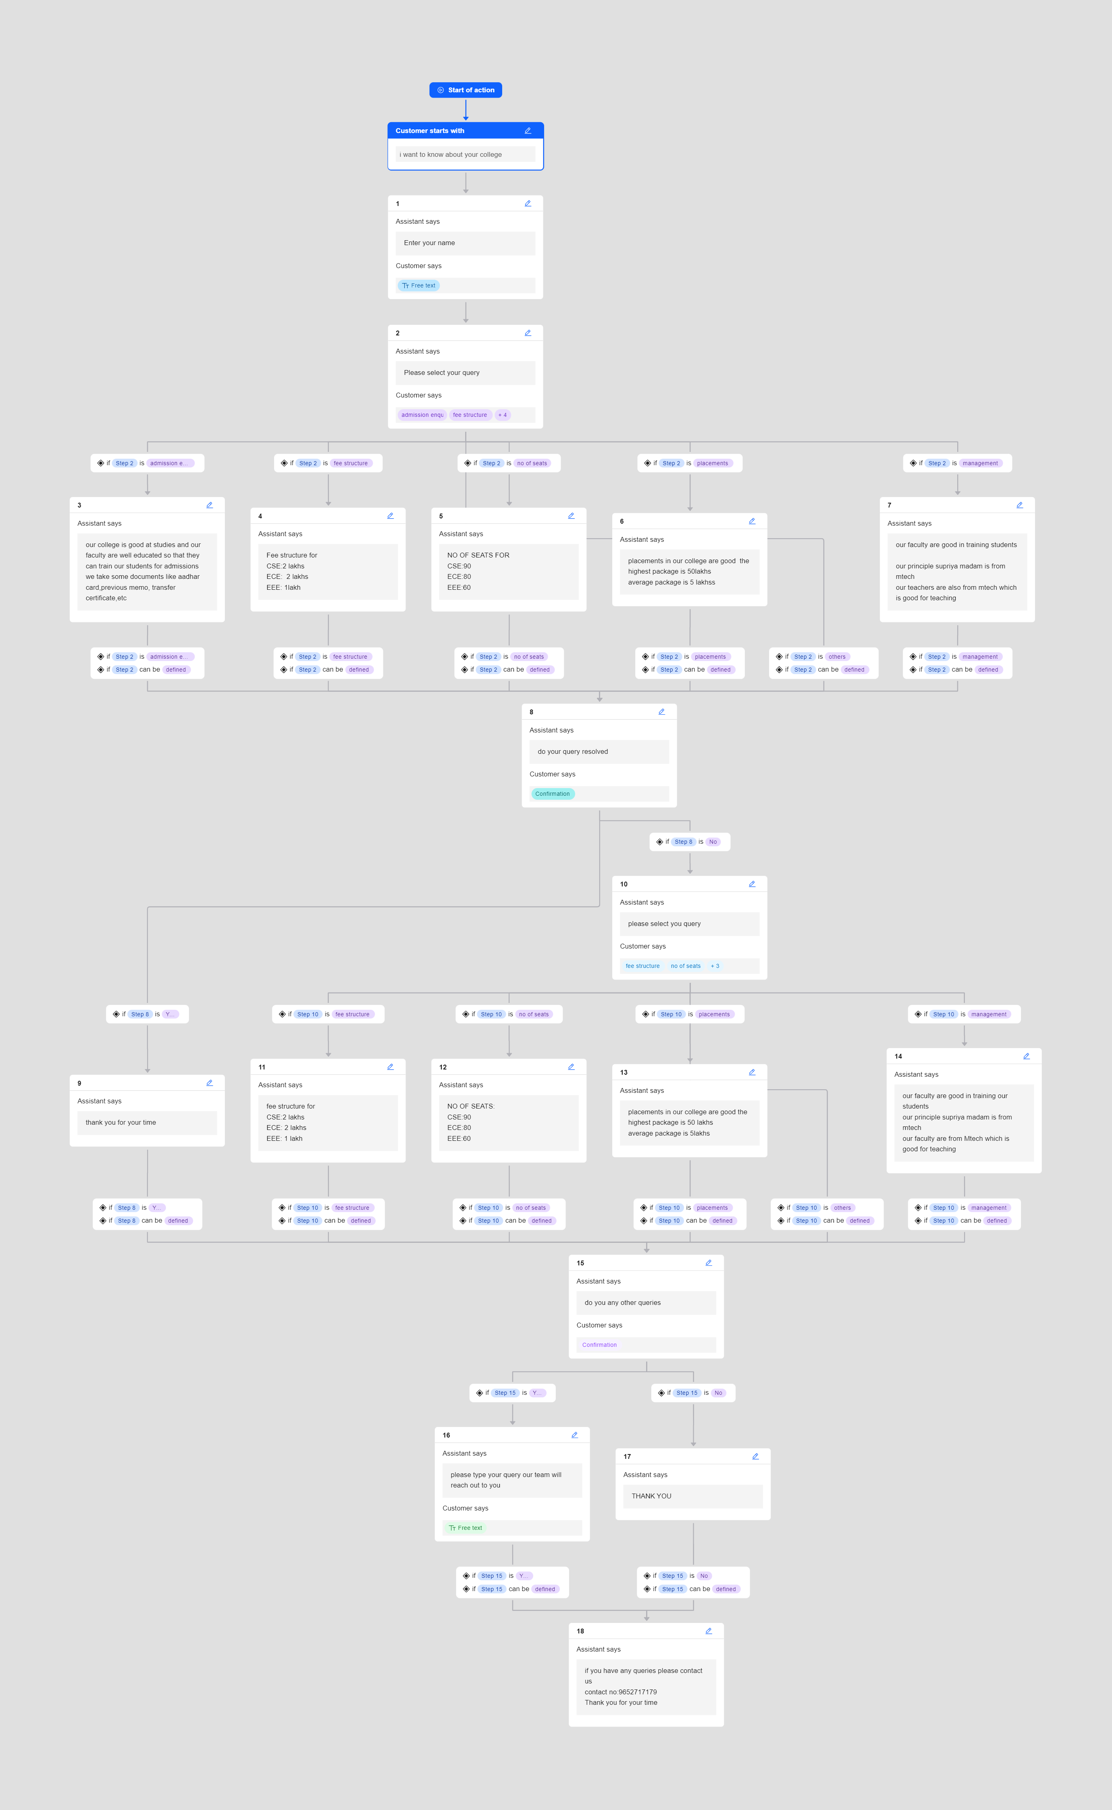
College chatbot
Add Your Professional Profile Photo Here
Program Feedback
Project Short Summary
The program is very useful to gain knowledge in AI domain the classes was very clear
The project is about the college chatbot chatbot answers the query of the users it consists information about college details ,admission , fees ,others
SANI SUPRIYA
sanisupriya9@gmail.com
malla reddy college of engineering for women
#skillsbuild

